Slide 1
Vaccines: Do We Really Need Them?
A look into National, State, and Regional trends.
Blake D. Johnson, MPH, MSW
August 12, 2024

Slide 2
Objectives
Objective 1: To educate on the CDC’s recommended vaccine schedule for children 0-6 years of age and to provide examples of illnesses that have been prevented by following the recommended schedule.
Objective 2: To educate community partners and healthcare providers on the risks of vaccine preventable illness outbreaks within Kentucky counties that vaccinated population is below the safety threshold of 95%.
Objective 3: To inspire healthcare providers and community partners to become vaccine champions when working with individual’s who are not up-to-date on vaccine recommendations.

Slide 3
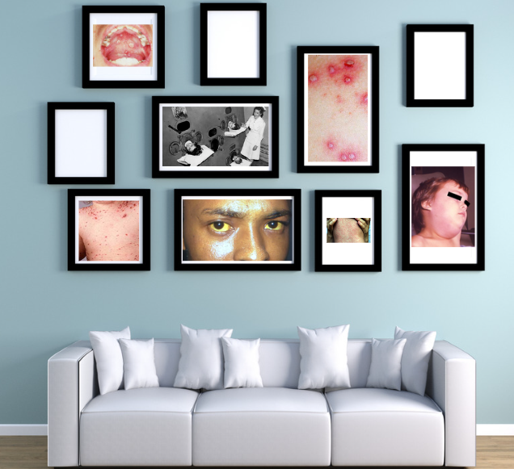
Photo Gallery
Image Source: KDPH created image using pictures from slides 4-10.
Notes:
Please close your eyes and imagine for a moment that you come home after a long day at work or running errands and within your home, you have a beautiful gallery wall highlighting photos of all your friends, family, and beloved pets. Once you have that image in your mind, please open your eyes, this is the gallery wall that you are looking at within your home. These photos show a history of illnesses that many children no longer have to worry about because we have vaccines that can prevent and/or provide high levels of protection against these illnesses. Photos include 1.) Polio 2.) Hepatitis A 3.) Varicella 4.) Varicella in the mouth 5.) Varicella with crusting lesions 6.) Measles 7.) Mumps

Slide 4
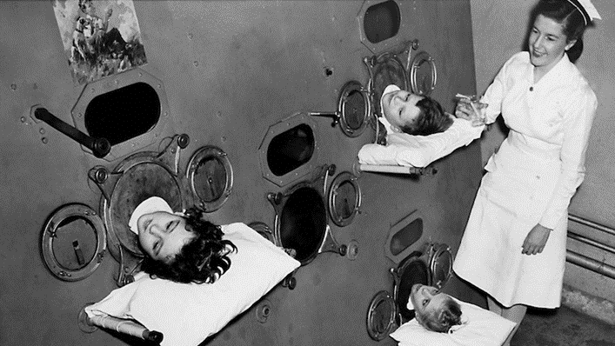
Polio
Image Source: https://answers.childrenshospital.org/poliovirus/

Slide 5
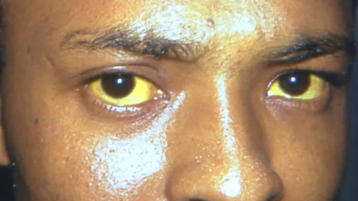
Hepatitis A
Image Source: https://outbreaknewstoday.substack.com/p/colombia-epidemiological-alert-is

Slide 6
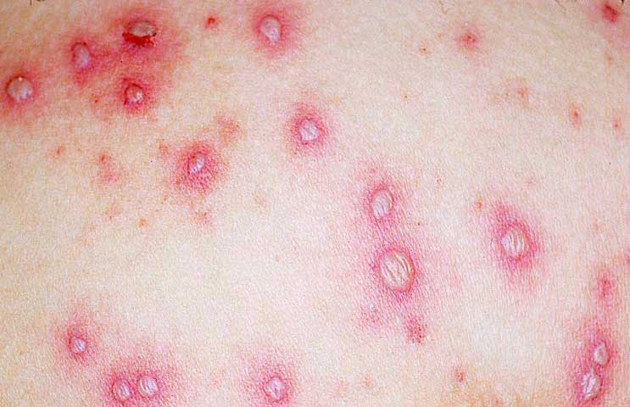
Varicella (early stage)
Image Source: https://www.rch.org.au/clinicalguide/guideline_index/Chickenpox_%28varicella%29/

Slide 7
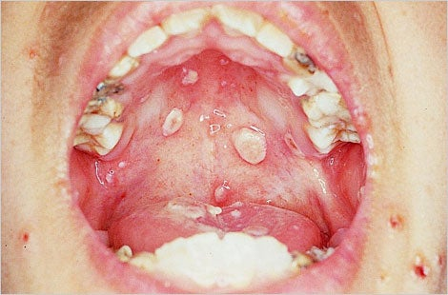
Varicella in Mouth
Image Source: https://www.immunize.org/clinical/image-library/varicella/

Slide 8
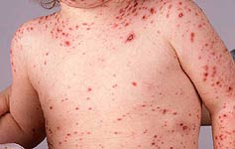
Varicella (later stage)
Image Source: https://www.rch.org.au/clinicalguide/guideline_index/Chickenpox_%28varicella%29/

Slide 9
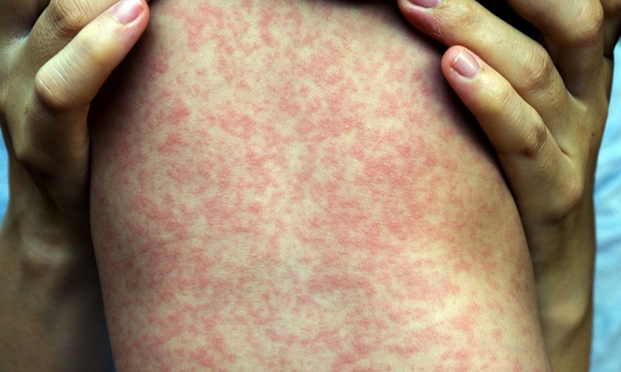
Measles
Image Source: https://www.nhsinform.scot/illnesses-and-conditions/infections-and-poisoning/measles/

Slide 10
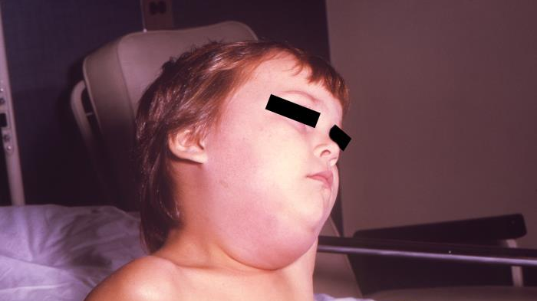
Mumps
Image Source: https://www.healthy.arkansas.gov/programs-services/topics/mumps

Slide 11
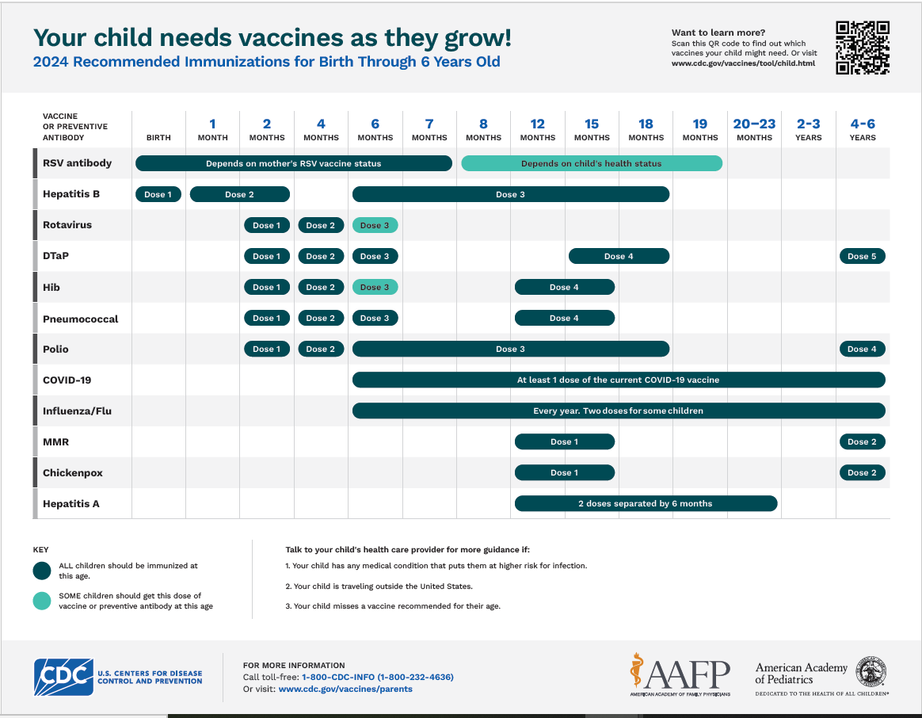
2024 Birth-6 Years Old Immunization Recommendations
Centers for Disease Control and Prevention (2024, August 14). Recommended Immunizations for Birth Through 6 Years Old, United States, 2024. Vaccines and Immunizations. Retrieved August 15, 2024, from https://www.cdc.gov/vaccines/imz-schedules/child-easyread.html
Notes:
https://www.cdc.gov/vaccines/imz-schedules/child-easyread.html
Vaccine recommendations Birth to 6 years of age

Slide 12
Let’s Talk About the Data!

Slide 13


CDC declared Measles was eliminated from the United State in 2000, after there were no new cases reported as exposure occurring within the U.S. for more than 12 months.
In July 2024, the World Health Organization published an article stating new data shows “nearly 3 in 4 infants live in a country where low vaccine coverage is driving measles outbreaks.” (WHO, 2024)
Centers for Disease Control and Prevention (2021, May 14). Vaccination Coverage and Exemption. SchoolVaxView. Retrieved August 15, 2024, from https://www.cdc.gov/vaccines/imz-managers/coverage/schoolvaxview/data-reports/index.html
Notes:
The eliminated of Measles was thanks to a highly effective vaccination program in the United States, as well as better measles control in the Americas region. By stating that no new cases was reporting occurring within the U.S., what this means is that if there was a case of Measles reported within the U.S. the cases would have been exposed while in another country.
In 2023, 83% of children worldwide had received their first dose of MMR vaccine and 74% of children had received the full dose series. To have herd immunity against measles, an estimated 95% of the population needs to be vaccinated. This helps to provide coverage to individuals who cannot receive a vaccine for health reasons and/or infants who are not yet old enough to receive the vaccine.
Measles has the highest % of individuals vaccinated compared to other diseases, so for the sake of this presentation, we will use 95% as the gold-standard for individuals being vaccinated.

Slide 14
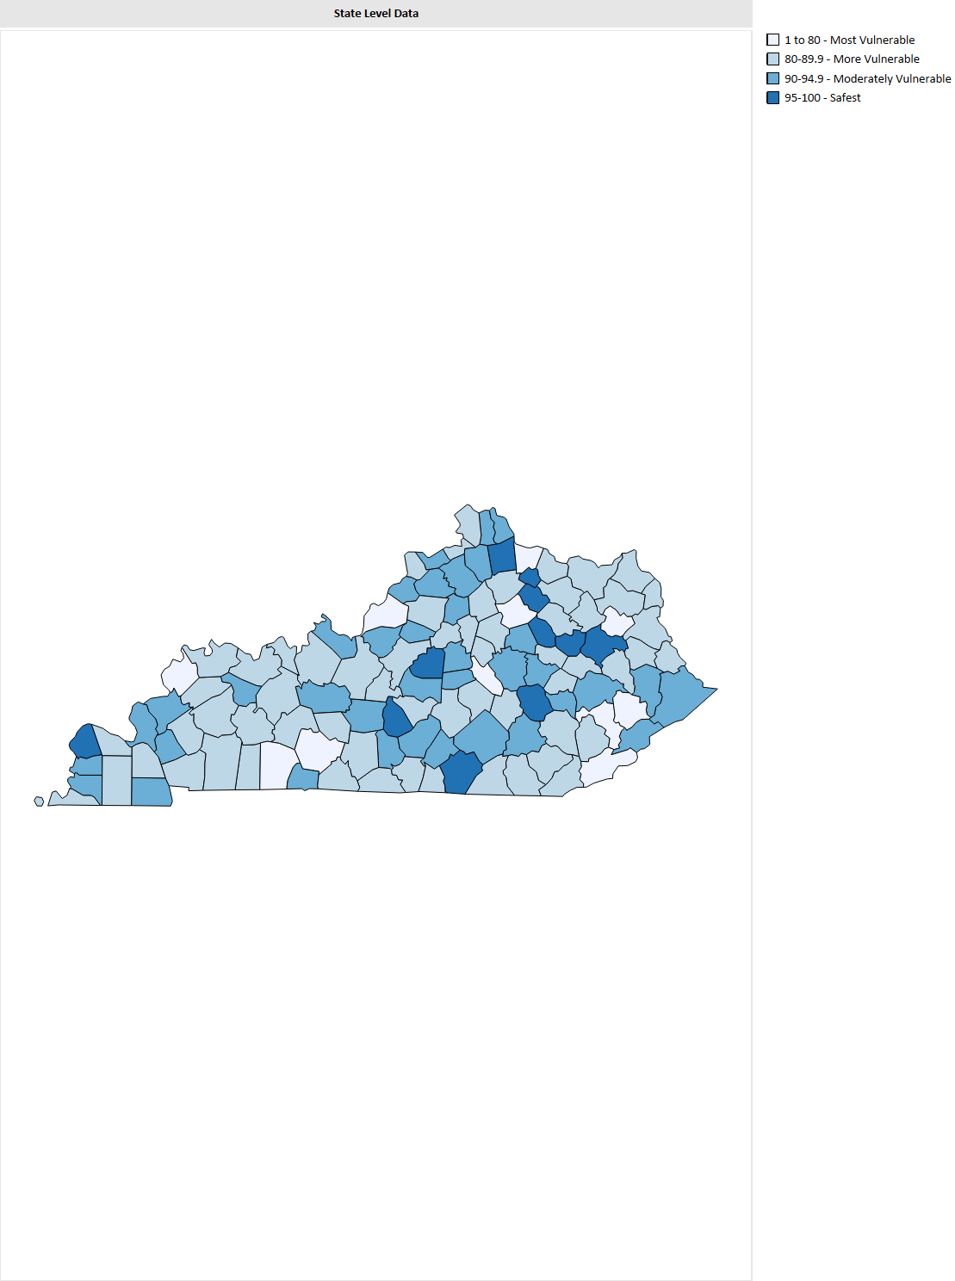
State and Regional Trends
The darkest blue are the counties considered safest from a vaccine preventable disease outbreak.
11 out of Kentucky’s 120 counties are categorized in the “Safest” category.
Kentucky Environmental Public Health Tracking (n.d.). Kentucky Immunization School Immunization Survey. School Immunizations Survey. Retrieved August 15, 2024, from https://healthtracking.ky.gov/Topics/immunizations/Pages/childhood-immunizations.aspx
Notes:
Every year, to be compliant with Kentucky Regulation 902 KAR 2:055, Kindergarten, public and private elementary and secondary schools must submit immunization data on the % of students in Kindergarten, Seventh, and Eleventh graders who are up-to-date on vaccine recommendations. Using that data, the Immunization Branch at the Kentucky Dept for Public Health and Environmental Public Health Tracking have built a dashboard that provides vaccine trends going back to 2018-2019 school year, as well as showing which the county level vulnerability of a vaccine preventable outbreak.
Wayne, Washington, Robertson, Pendleton, Nicholas, Morgan, Montgomery, Menifee, Jackson, Green, Ballard.

Slide 15


Purchase Region- Kindergarten Immunizations
Purchase Region – Has 1 of the 11 counties in Kentucky that meets the benchmark to be considered “safest” from a VPD outbreak.
4 of the 8 counties within the region are considered “More Vulnerable” to a VPD outbreak.
Kentucky Environmental Public Health Tracking (n.d.). Kentucky Immunization School Immunization Survey. School Immunizations Survey. Retrieved August 15, 2024, from https://healthtracking.ky.gov/Topics/immunizations/Pages/childhood-immunizations.aspx
Notes:
Something to keep in mind when looking at this data is that to calculate the %’s, we must look at the number of kindergartener’s for that particular year. So in counties with a smaller overall population, such as Ballard, it would be easier to reach a higher level of Kindergarteners vaccinated, than what it might be in McCracken County. But when we have county’s with a smaller population and a lower number of Kindergartners vaccinated, like in Marshall, Public Health needs to start looking at how to address vaccine hesitancy.

Slide 16
Vaccine Hesitancy

Slide 17
Complacency
Confidence
Convenience

Slide 18
Confidence
1800s- Anti-Vaccination League, England
1879- Anti-Vaccination Society of America
1905-The first Supreme Court ruling on the power of states in public health laws
  The Supreme Court ruled that a state count enact mandatory laws to protect the public in the event of a communicable disease.
1974- Neurological concerns linked to DTP vaccine
  Reports alleged 36 children in the UK had been hospitalized with neurological conditions following DTP vaccine.
1982- DTP documentary in the United States
1998- Andrew Wakefield and the Lancet Journal
1990s- Thimerosal controversy
Notes:
Many people would be quick to say vaccine hesitancy began with Covid.
The anti-vaccination league was formed to in response to mandatory vaccination acts of infants and children up to 14 years of age for smallpox, following Edward Jenner’s cowpox experiments.
1974- 36 children were allegedly hospitalized with neurological complications after receiving a DTP vaccine. This led to outrage and confusion from parents, which was exacerbated by medical providers who were reluctant to recommend immunizations, such as Gordon Stewart. Dr. Stewart was an English physician and vaccine opponent who published several reports that pointed fingers at DTP vaccine causing neurological disorders in children. These reports led to the Joint Commision of Vaccination and Immunization to create the National Childhood Encephalopathy Study. This study analyzed every child between 2 and 36 months of age who had been hospitalized with neurological illness and assessed whether immunization was associated with increased risk. The study found the risk was very low and the risk did not outweigh the benefits of vaccine.

Slide 19
Complacency
2000’s- Elimination of measles from United States
1940-1980- Number of pertussis cases decreased each year more than 90%
1980-2012- Pertussis cases remain low (peak in 2012 at 48,277 compared to 200,000+ before 1940), cases have been on the rise since 1980.

Slide 20
Convenience
Access to transportation
Health insurance and affordability
Accessibility and understanding of language
Accessibility and understanding of information

Slide 21
Outbreaks

Slide 22
Kentucky Vaccine-Related Outbreaks
2017-2019 Hepatitis A
2020- COVID-19
2022-2023- Mpox
2023- Measles exposure at Asbury
  This was not technically an outbreak but required an outbreak response

Slide 23
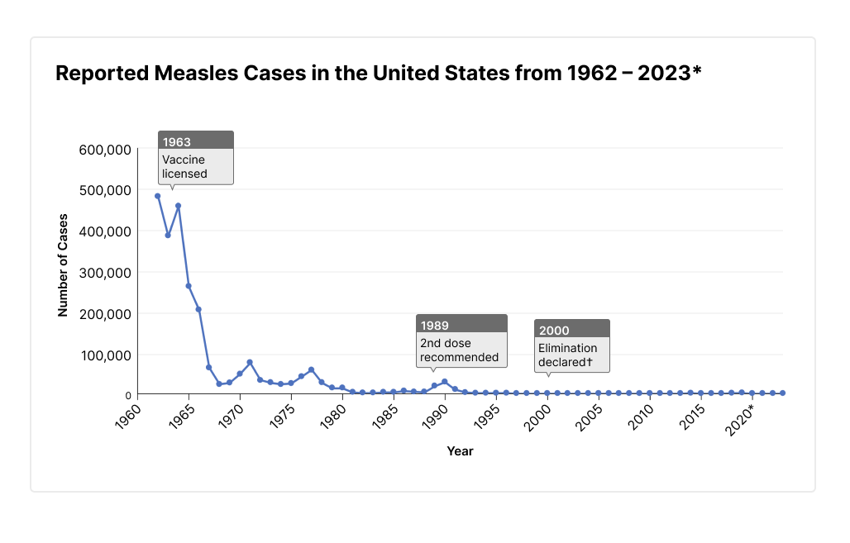
Measles
Between January 1-December 31, 2023, 59 cases of measles was reported in the United States.
As of August 15, 2024, 219 cases and 13 outbreaks of measles have been reported. 150 (68%) of the measles cases have been outbreak-associated.
  40% were under the age of 5
  87% were unvaccinated or had unknown vaccine status
Centers for Disease Control and Prevention (2024, August 15). Measles Cases and Outbreaks. Measles (Rubeola). Retrieved August 15, 2024, from https://www.cdc.gov/measles/data-research/index.html

Slide 24
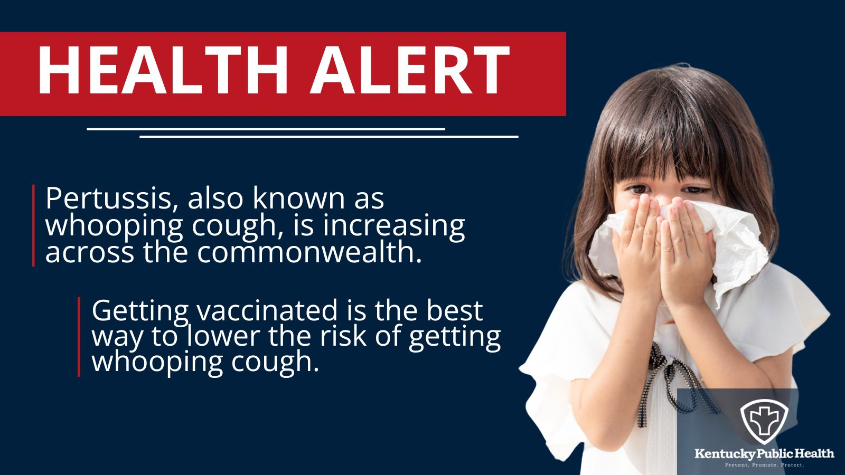
Pertussis
In 2023, Kentucky reported 94 cases of pertussis. The United States reported 5,611 cases, an increase of 3,223 from 2022.
July 14, 2024, Kentucky sent out a Kentucky Health Alert to healthcare providers across the state after noting an increase in pertussis cases.
  As of July 14- 130 cases in 34 counties have been reported.
Kentucky Department for Public Health (2024, July 17). Increase in Pertussis in Kentucky- Recommendations for Identification and Prevention. KY Cabinet for Health and Family Services. Retrieved August 15, 2024, from https://www.chfs.ky.gov/agencies/dph/dehp/idb/Pages/PertussisKYAug2023.aspx

Slide 25
Summary
Vaccines are one of the most successful and cost-effective tool at preventing disease and death.
Vaccines are not just for children! As we age, many of us forget to stay up to date on vaccines. Information about vaccine recommendations for adults can be found at CDC’s website under “Recommended Vaccinations for Adults.”
Vaccination recommendations for pregnant women can be found at CDC’s website under “Pregnancy and Vaccinations”.

Slide 26
Blake D. Johnson, MPH, MSW
BD.Johnson@ky.gov
502-382-6438

Slide 27
Livingston, K. A., Rosen, J. B., Zucker, J. R., & Zimmerman, C. M. (2014). Mumps vaccine effectiveness and risk factors for disease in households during an outbreak in New York City. Vaccines, 32(9), 369-374. https://doi.org/10.1016/j.vaccine.2013.11.021Otani N, Shima M, Ueda T, Nakajima K, Takesue Y, Yamamoto T, Okuno T. Changes in the Epidemiology of Rubella: The Influence of Vaccine-Introducing Methods and COVID-19. Vaccines (Basel). 2023 Aug 12;11(8):1358. doi: 10.3390/vaccines11081358. PMID: 37631927; PMCID: PMC10458369.
[U.S. Food and Drug Administration]. (2022, April 25). What is that sound? Whooping Cough [Video]. YouTube. https://youtu.be/DB70izafC1Y?si=QJfJbpqlwfqRe5-u
McAlpine, K. J. (2017, April 20). Culture shock: Why poliovirus had to live before it could die. Retrieved August 15, 2024, from https://answers.childrenshospital.org/poliovirus/
Herriman, R. (2024, April 18). Colombia: Epidemiological alert is issued in Medellín due to an unusual increase in hepatitis A. Outbreak News. Retrieved August 15, 2024, from https://outbreaknewstoday.substack.com/p/colombia-epidemiological-alert-is
(2021, July 1). Clinical Practice Guidelines for Chickenpox (Varicella). The Royal Children's Hospital Melbourne. Retrieved August 15, 2024, from https://www.rch.org.au/clinicalguide/guideline_index/Chickenpox_%28varicella%29/
(2023, October 18). Varicella (Chickenpox). Immunize.org. Retrieved August 15, 2024, from https://www.immunize.org/clinical/image-library/varicella/
(2023, November 24). Measles. NHS Inform. Retrieved August 15, 2024, from https://www.nhsinform.scot/illnesses-and-conditions/infections-and-poisoning/measles/
(n.d.). Mumps. Arkansas Department of Health. Retrieved August 15, 2024, from https://www.healthy.arkansas.gov/programs-services/topics/mumps
Centers for Disease Control and Prevention (2021, May 14). Vaccination Coverage and Exemption. SchoolVaxView. Retrieved August 15, 2024, from https://www.cdc.gov/vaccines/imz-managers/coverage/schoolvaxview/data-reports/index.html
World Health Organization (2024, July 15). Global childhood immunization levels stalled in 2023, leaving many without life-saving protection. Retrieved August 15, 2024, from https://www.who.int/news/item/15-07-2024-global-childhood-immunization-levels-stalled-in-2023-leaving-many-without-life-saving-protection
Kentucky Environmental Public Health Tracking (n.d.). Kentucky Immunization School Immunization Survey. School Immunizations Survey. Retrieved August 15, 2024, from https://healthtracking.ky.gov/Topics/immunizations/Pages/childhood-immunizations.aspx
Centers for Disease Control and Prevention (n.d.). Pertussis Surveillance and Trends. Whooping Cough. Retrieved August 15, 2024, from https://www.cdc.gov/pertussis/php/surveillance/index.html
Thompson S, Meyer JC, Burnett RJ, Campbell SM. Mitigating Vaccine Hesitancy and Building Trust to Prevent Future Measles Outbreaks in England. Vaccines (Basel). 2023 Jan 28;11(2):288. doi: 10.3390/vaccines11020288. PMID: 36851166; PMCID: PMC9962700.
Sutherland, A. (n.d.). The Thimerosal Controversy. Retrieved August 15, 2024, from /https://vtechworks.lib.vt.edu/server/api/core/bitstreams/38ab746d-2182-4da3-917f-82578aa4ab98/content
Centers for Disease Control and Prevention (2024, August 15). Measles Cases and Outbreaks. Measles (Rubeola). Retrieved August 15, 2024, from https://www.cdc.gov/measles/data-research/index.html
Kentucky Department for Public Health (2024, July 17). Increase in Pertussis in Kentucky- Recommendations for Identification and Prevention. KY Cabinet for Health and Family Services. Retrieved August 15, 2024, from https://www.chfs.ky.gov/agencies/dph/dehp/idb/Pages/PertussisKYAug2023.aspx
Centers for Disease Control and Prevention (2024, March 24). 2023 Provisional Pertussis Surveillance Report. Retrieved August 15, 2024, from https://www.cdc.gov/pertussis/php/surveillance/#cdc_generic_section_4-data-reporting
The college of physicians in Philadelphia (n.d.). History of Anti-Vaccination Movements. History of Vaccines. Retrieved August 15, 2024, from https://historyofvaccines.org/vaccines-101/misconceptions-about-vaccines/history-anti-vaccination-movements
Centers for Disease Control and Prevention (2024, August 14). Recommended Immunizations for Birth Through 6 Years Old, United States, 2024. Vaccines & Immunizations. Retrieved August 15, 2024, from https://www.cdc.gov/vaccines/imz-schedules/child-easyread.html

